Slide 1


THE COMPREHENSIVE WORLD OF COMPUTER SCIENCE : FROM FUNDAMENTAL TO EMERGING TRENDS
BY N Pavan Kumar
TREDENCE | Connect the Dots | www.tredence.com

Slide 2

Defining Computer Science
It is the study of algorithms, data structures, and the principles of computation
Importance of Computer Science
Computer Science vs Computer Science and Engineering
Diverse Applications
Theoretical and Practical Aspects

Slide 3
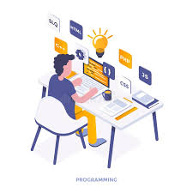



Key Pillars of Computer Science
Programming
Data Structures & Algorithms
Cybersecurity
Web Development

Slide 4


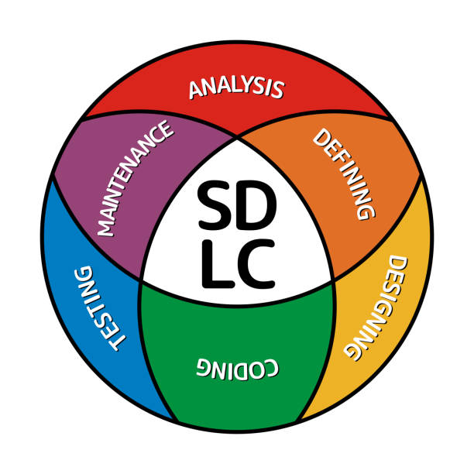


Key Pillars of Computer Science
Artificial Intelligence
Emerging Technologies
Software Development
Life Cycle
Machine Learning
Career Paths

Slide 5

Programming
Set of Instructions
Importance of Programming
Programmer’s Job ?
Basic Fundamental Programming concepts
Stop Studying Programming
Stick to a single Programming language in the beginning

Slide 6
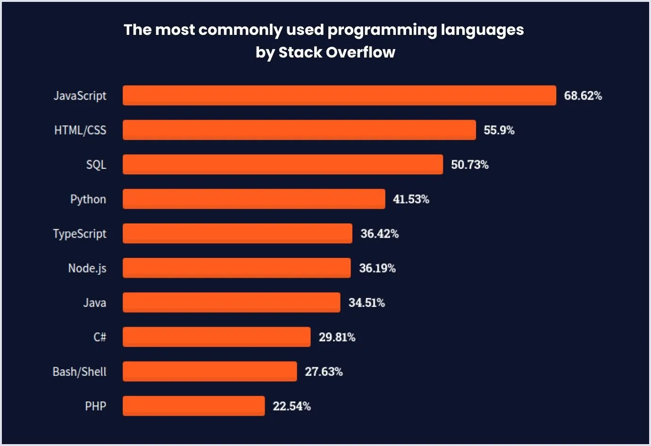
Top Programming Languages

Slide 7


Data Structures & Algorithms
Organize and Store Data
Effective Code
Common Data Structures
Application of Data Structures
Step by Step instructions to
Solve problems

Slide 8



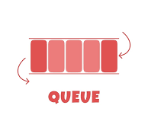

Data Structures & Algorithms

Slide 9
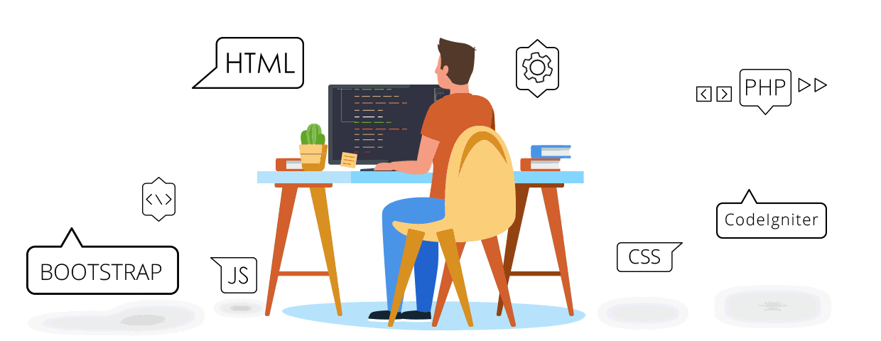
Web Development
Building and Maintaining Web Applications
Significance of Web Development
Front End Development
Back End Development
Full Stack Development

Slide 10
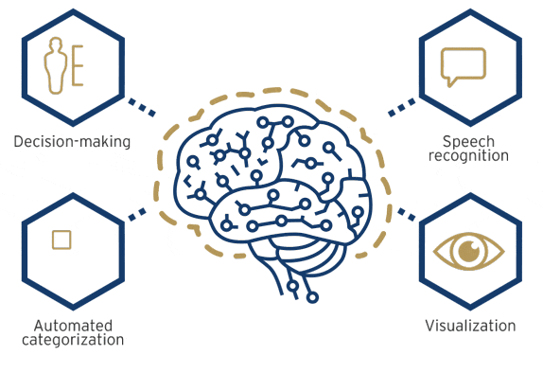
Artificial Intelligence
Enable machines to understand learn and make decisions
Capability of performing on their own
Embedded in online services
A program that can sense, reason, act and adapt

Slide 11
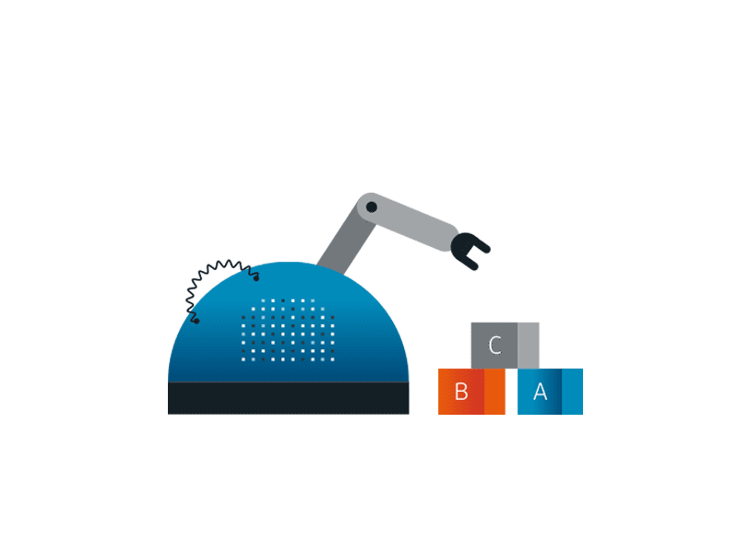
Machine Learning
It is Subset of AI
Algorithms that help machine to learn and improve
Nature Language Processing
Computer Vision
Recommendation Systems

Slide 12





Emerging Technologies

Slide 13






Key Skills for success in IT Industry

Slide 14
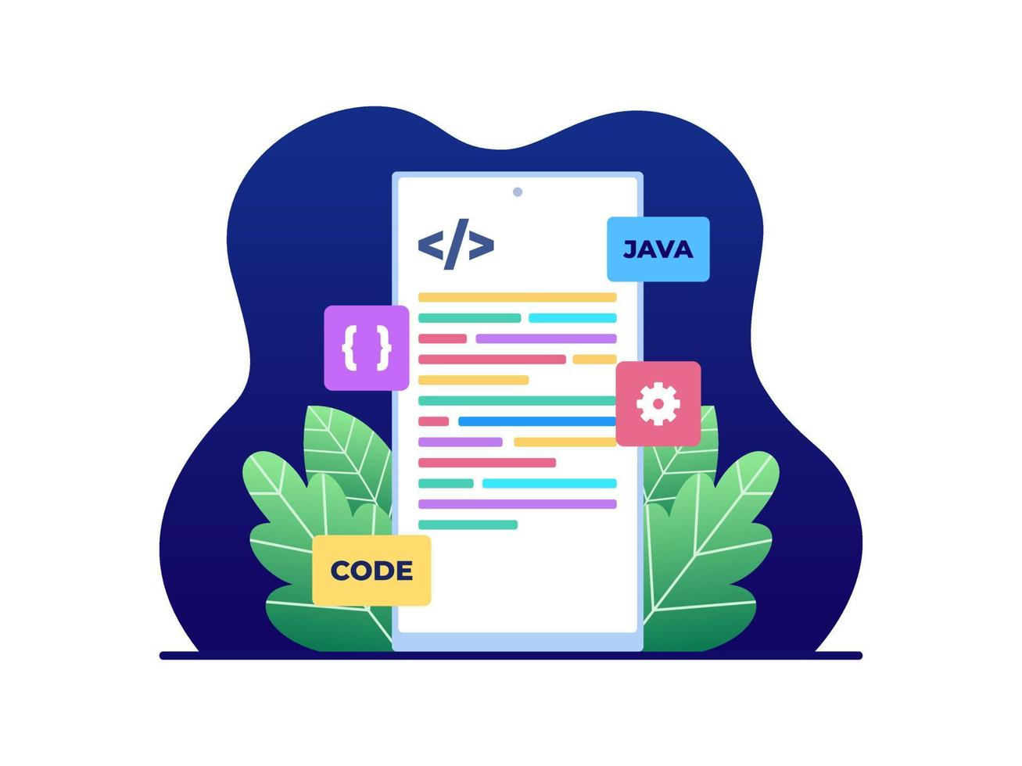
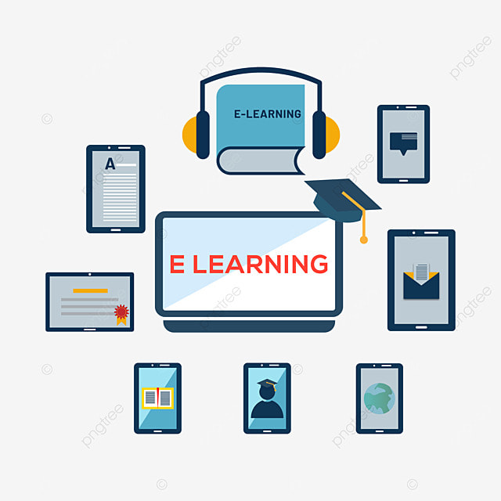



Cultivating Industry Ready Skills

Slide 15

Career Paths
Software Development
Web Development
AI and ML
Cyber Security
IT management
Network Engineer
Database Administrator

Slide 16




Essential Tools

Slide 17





Learning Resources and Pathways

Slide 18

Q and A Interaction

Slide 19
7075618058
pavan.k@tredence.com

